Slide 1
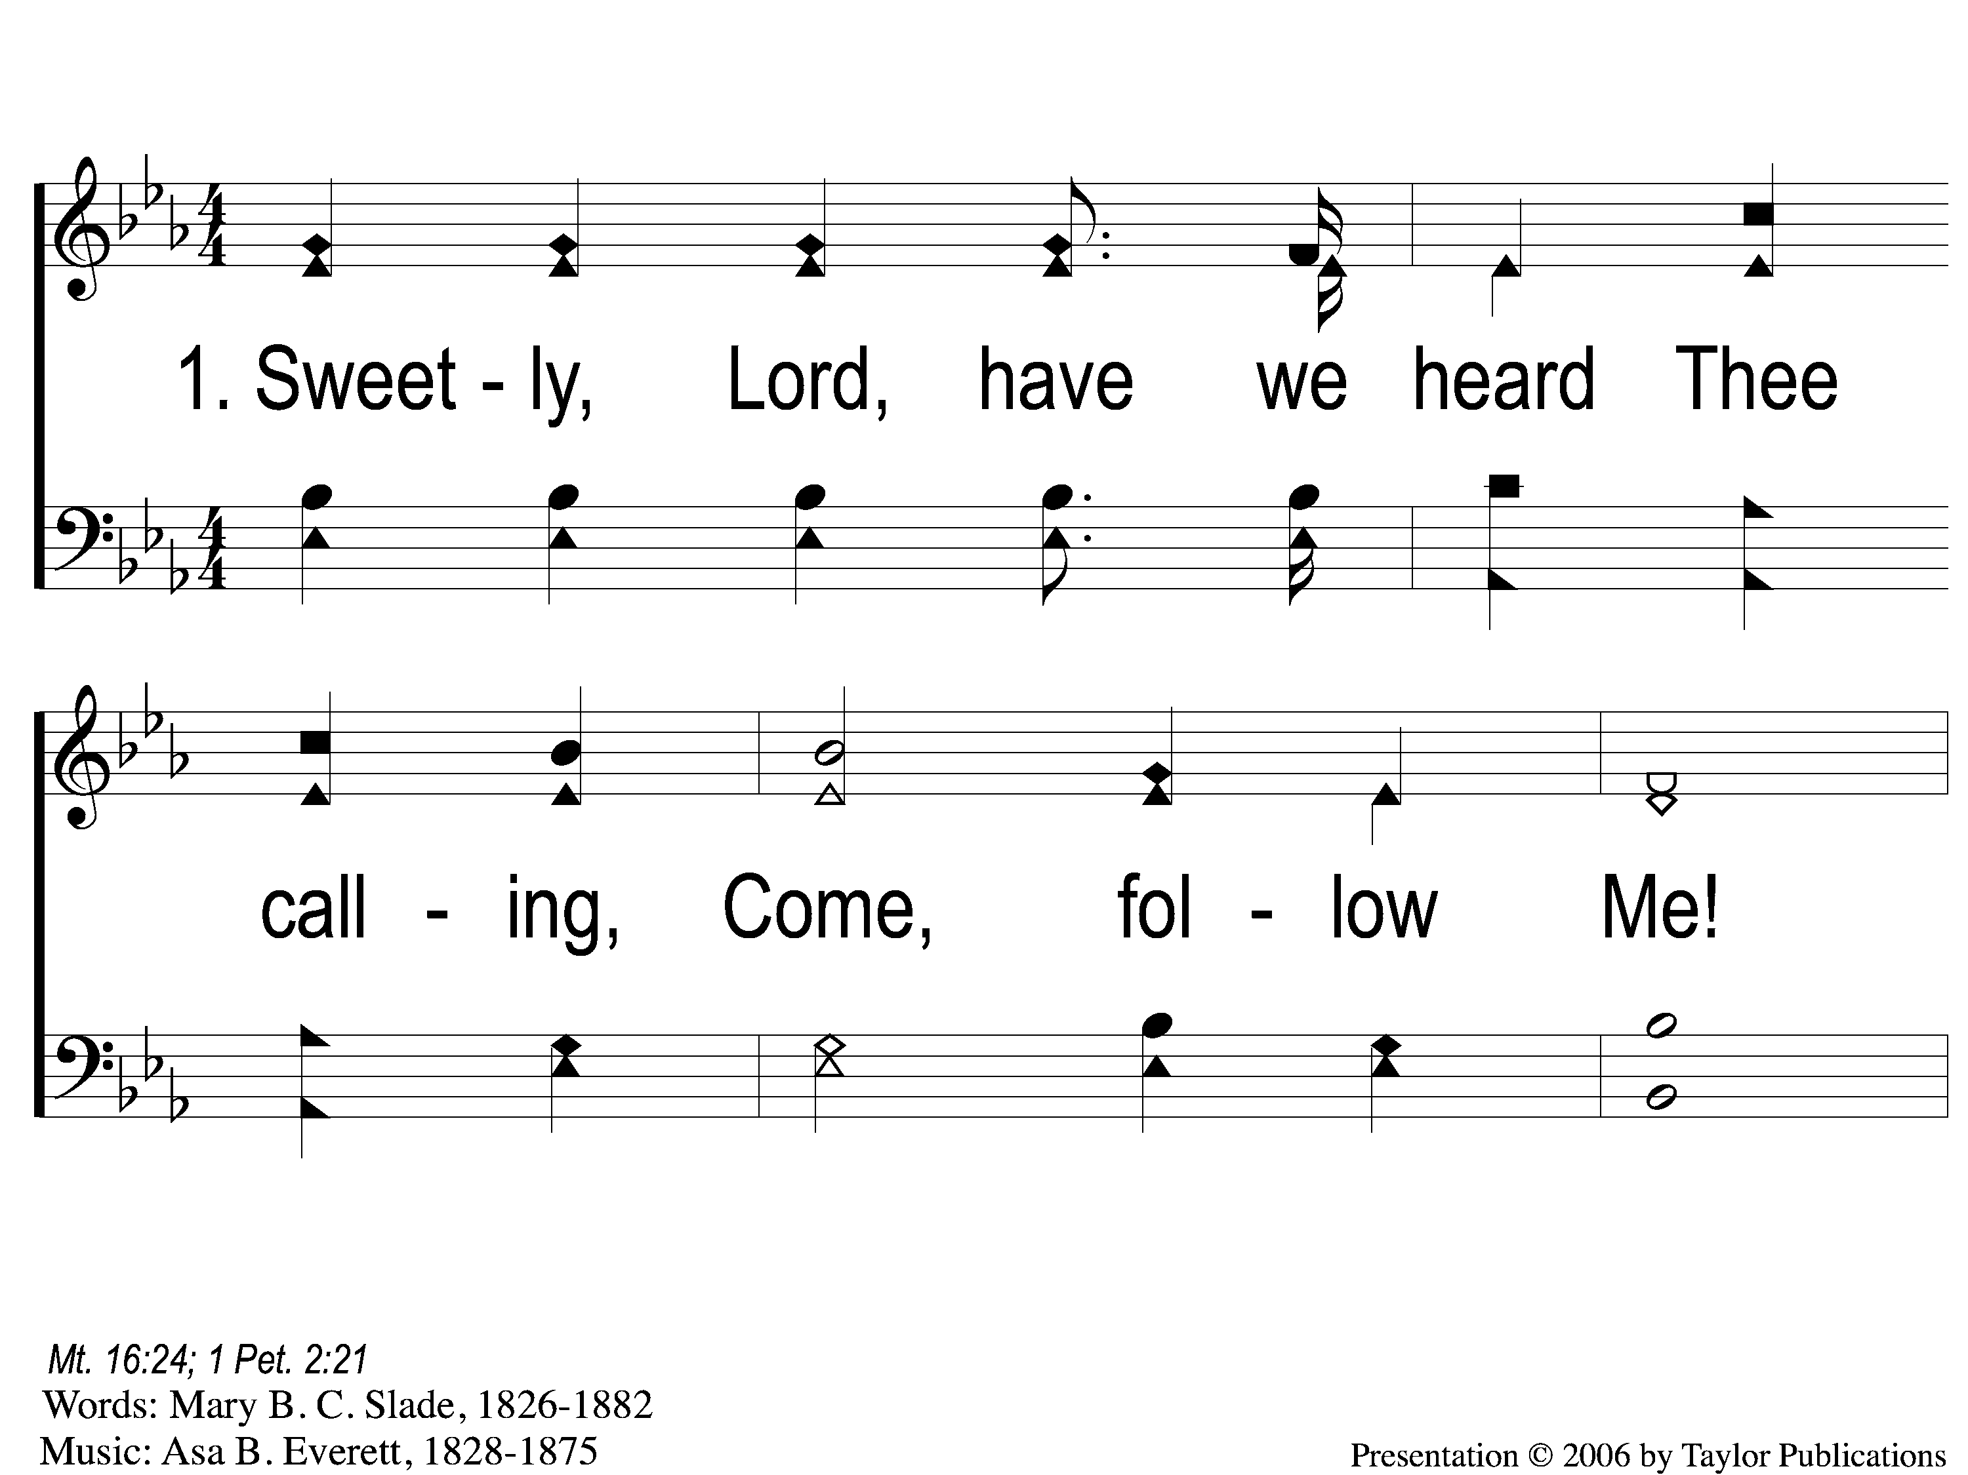
1-1 Footprints of Jesus
Footprints Of Jesus
113

Slide 2
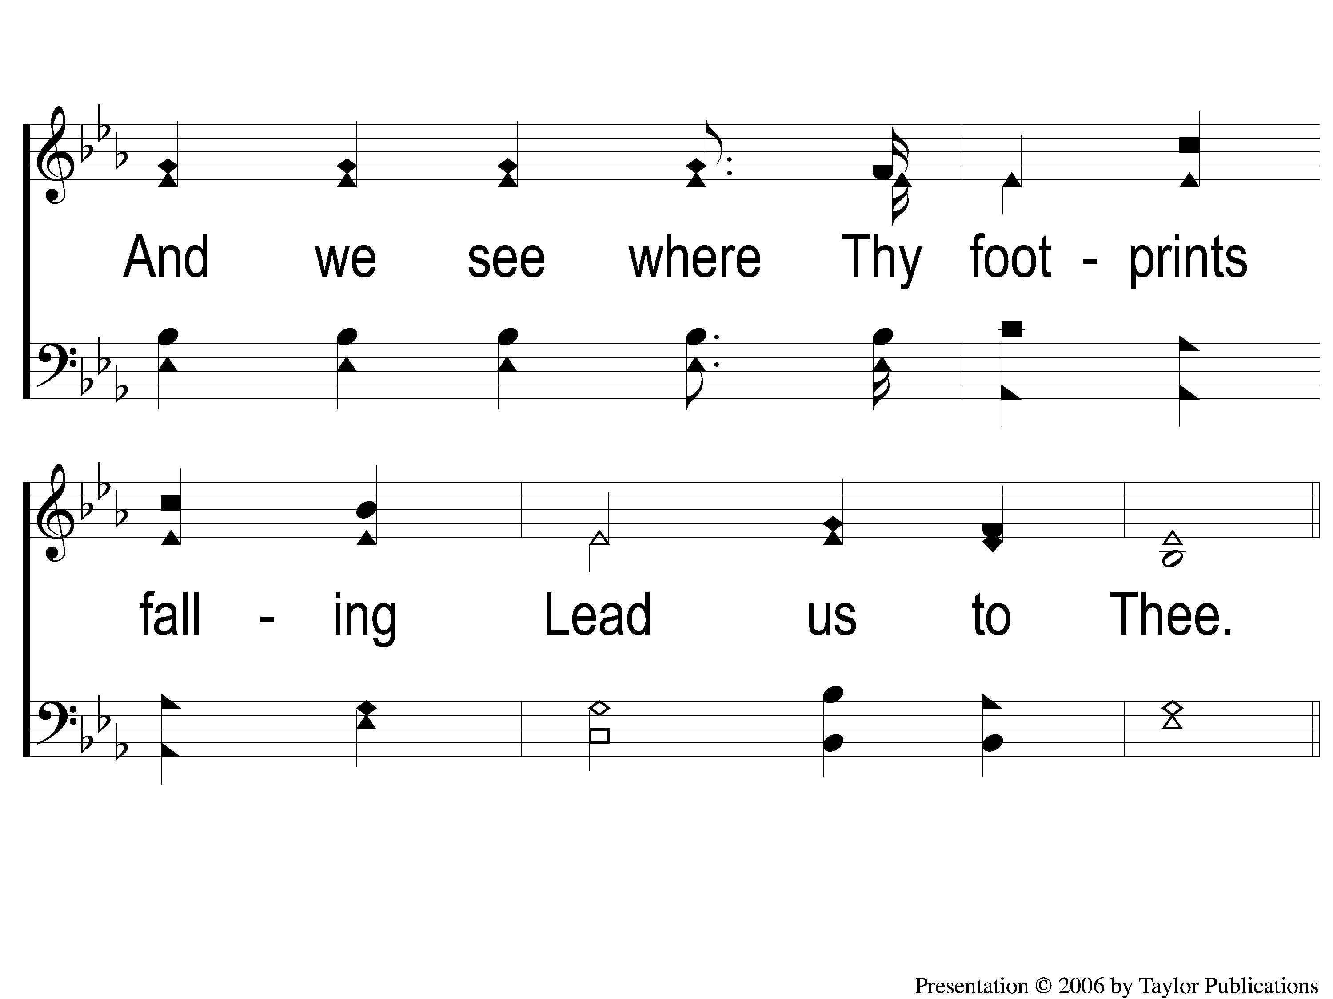
1-2 Footprints of Jesus
Footprints Of Jesus
113

Slide 3
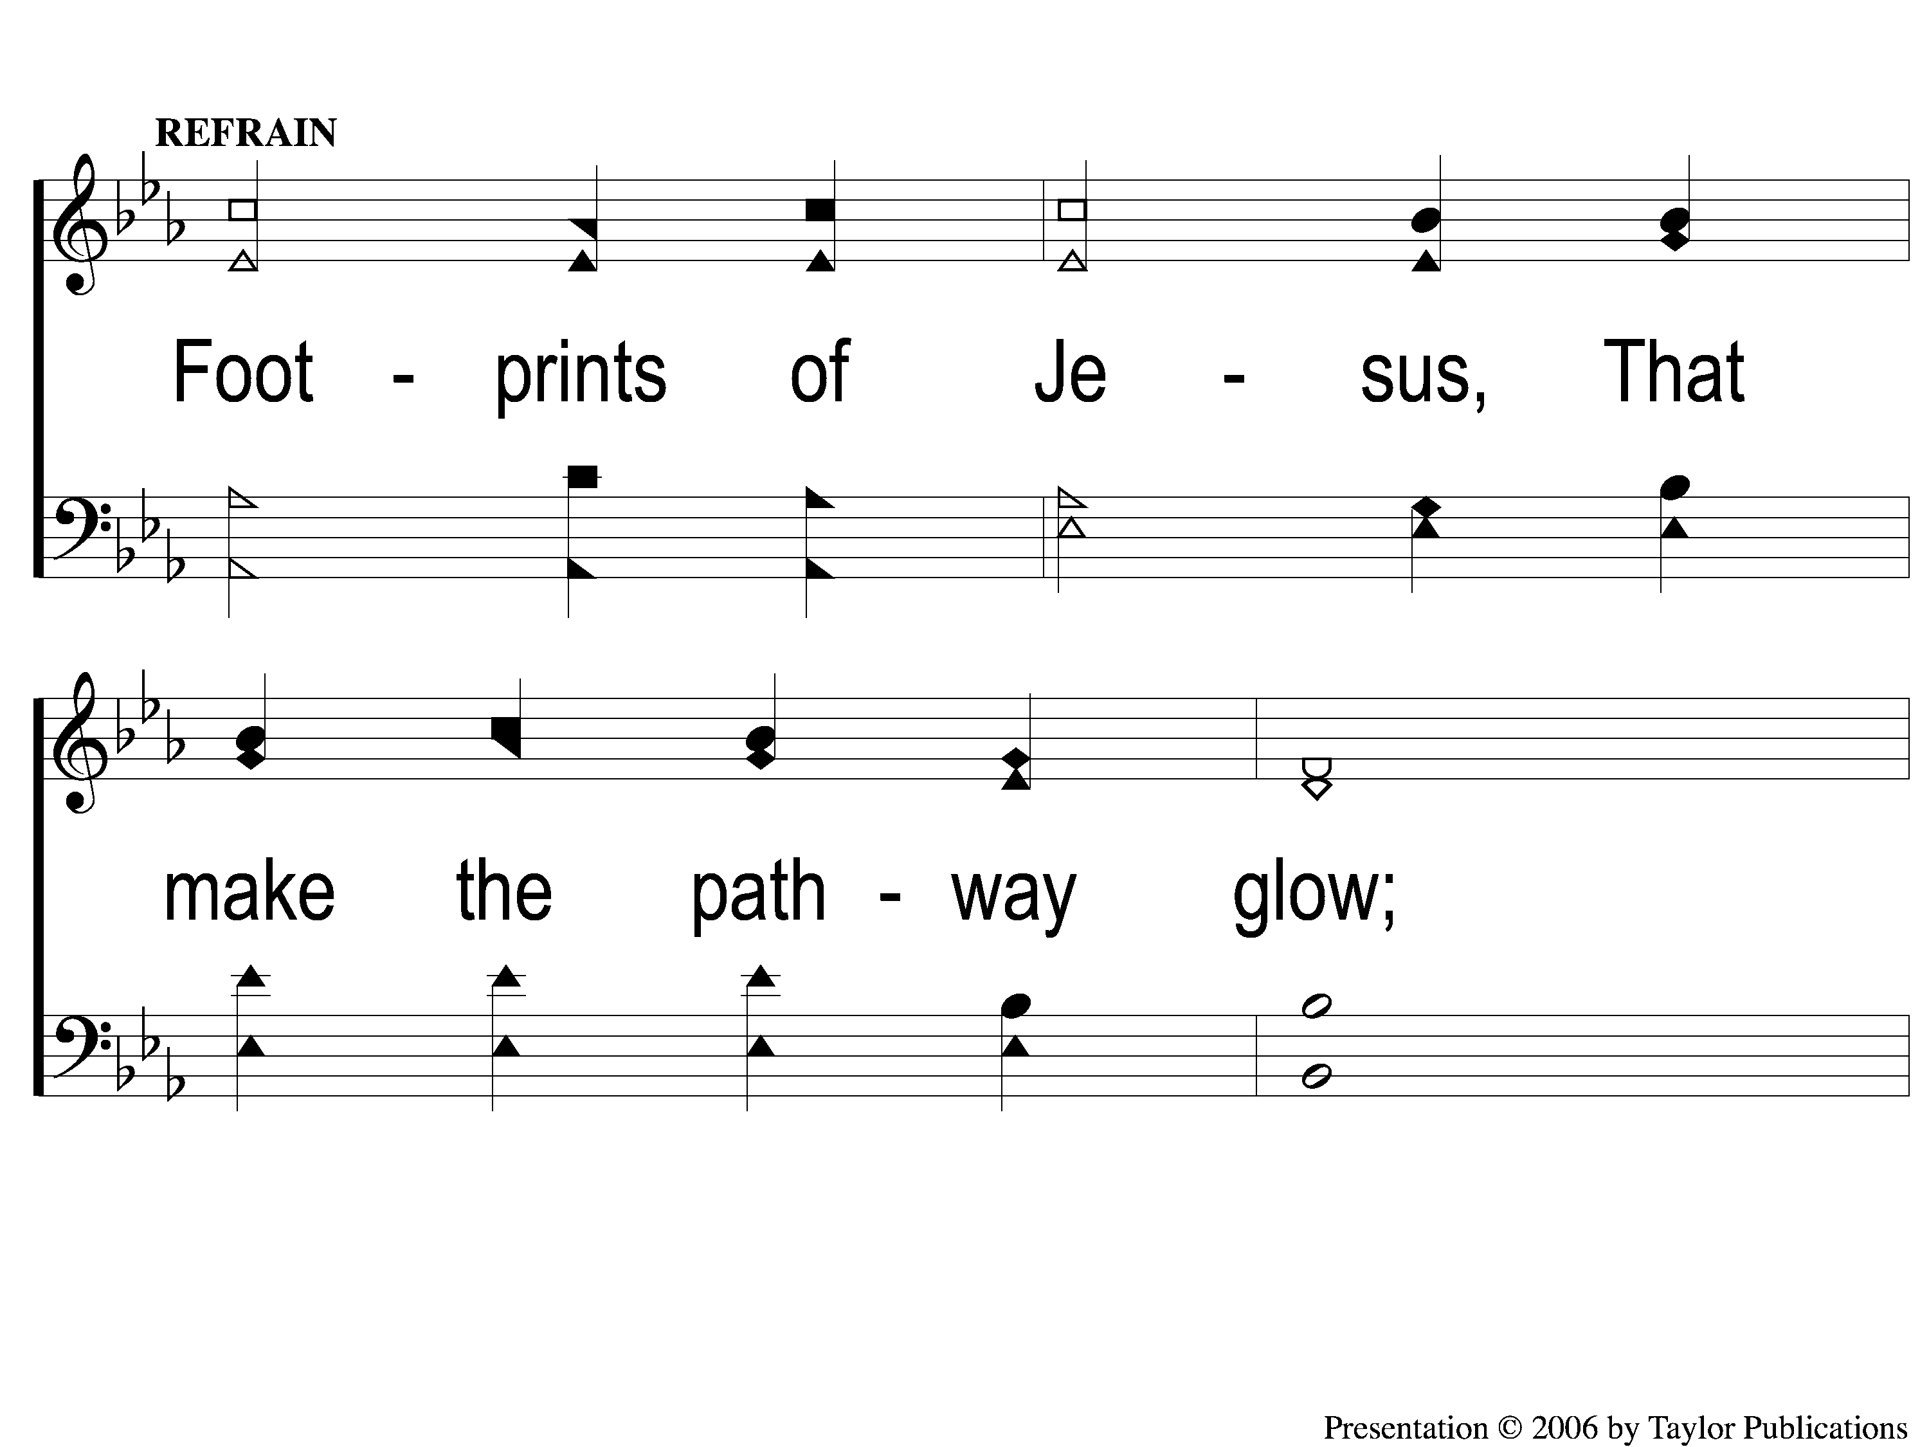
C-1 Footprints of Jesus
Footprints Of Jesus
113

Slide 4
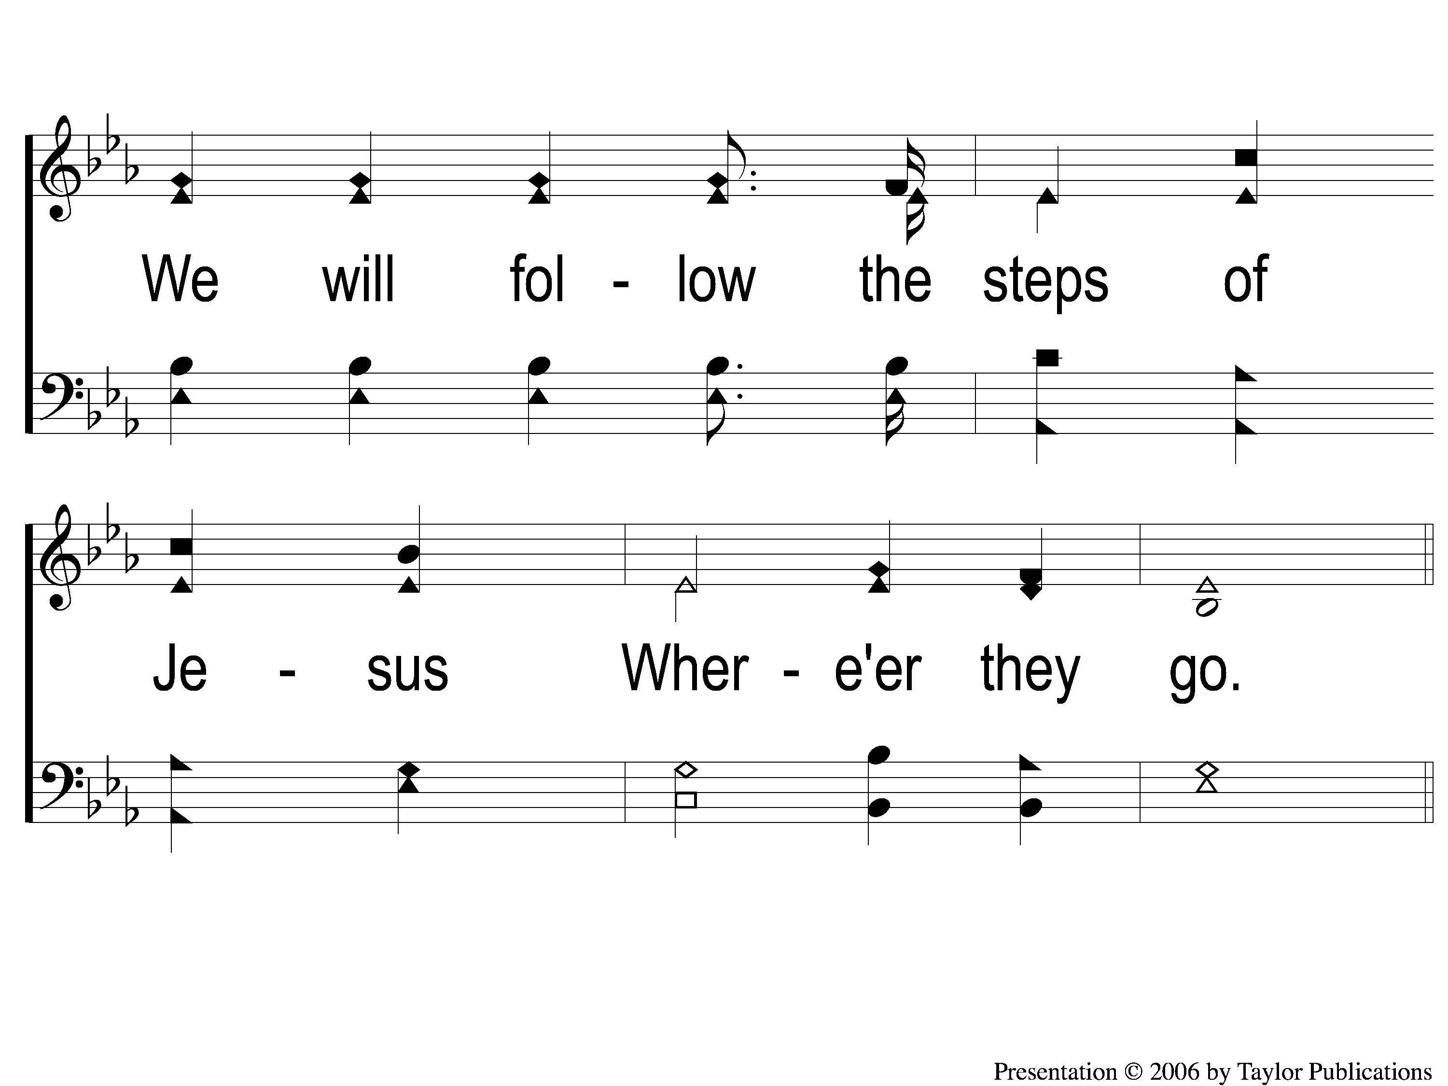
C-2 Footprints of Jesus
Footprints Of Jesus
113

Slide 5
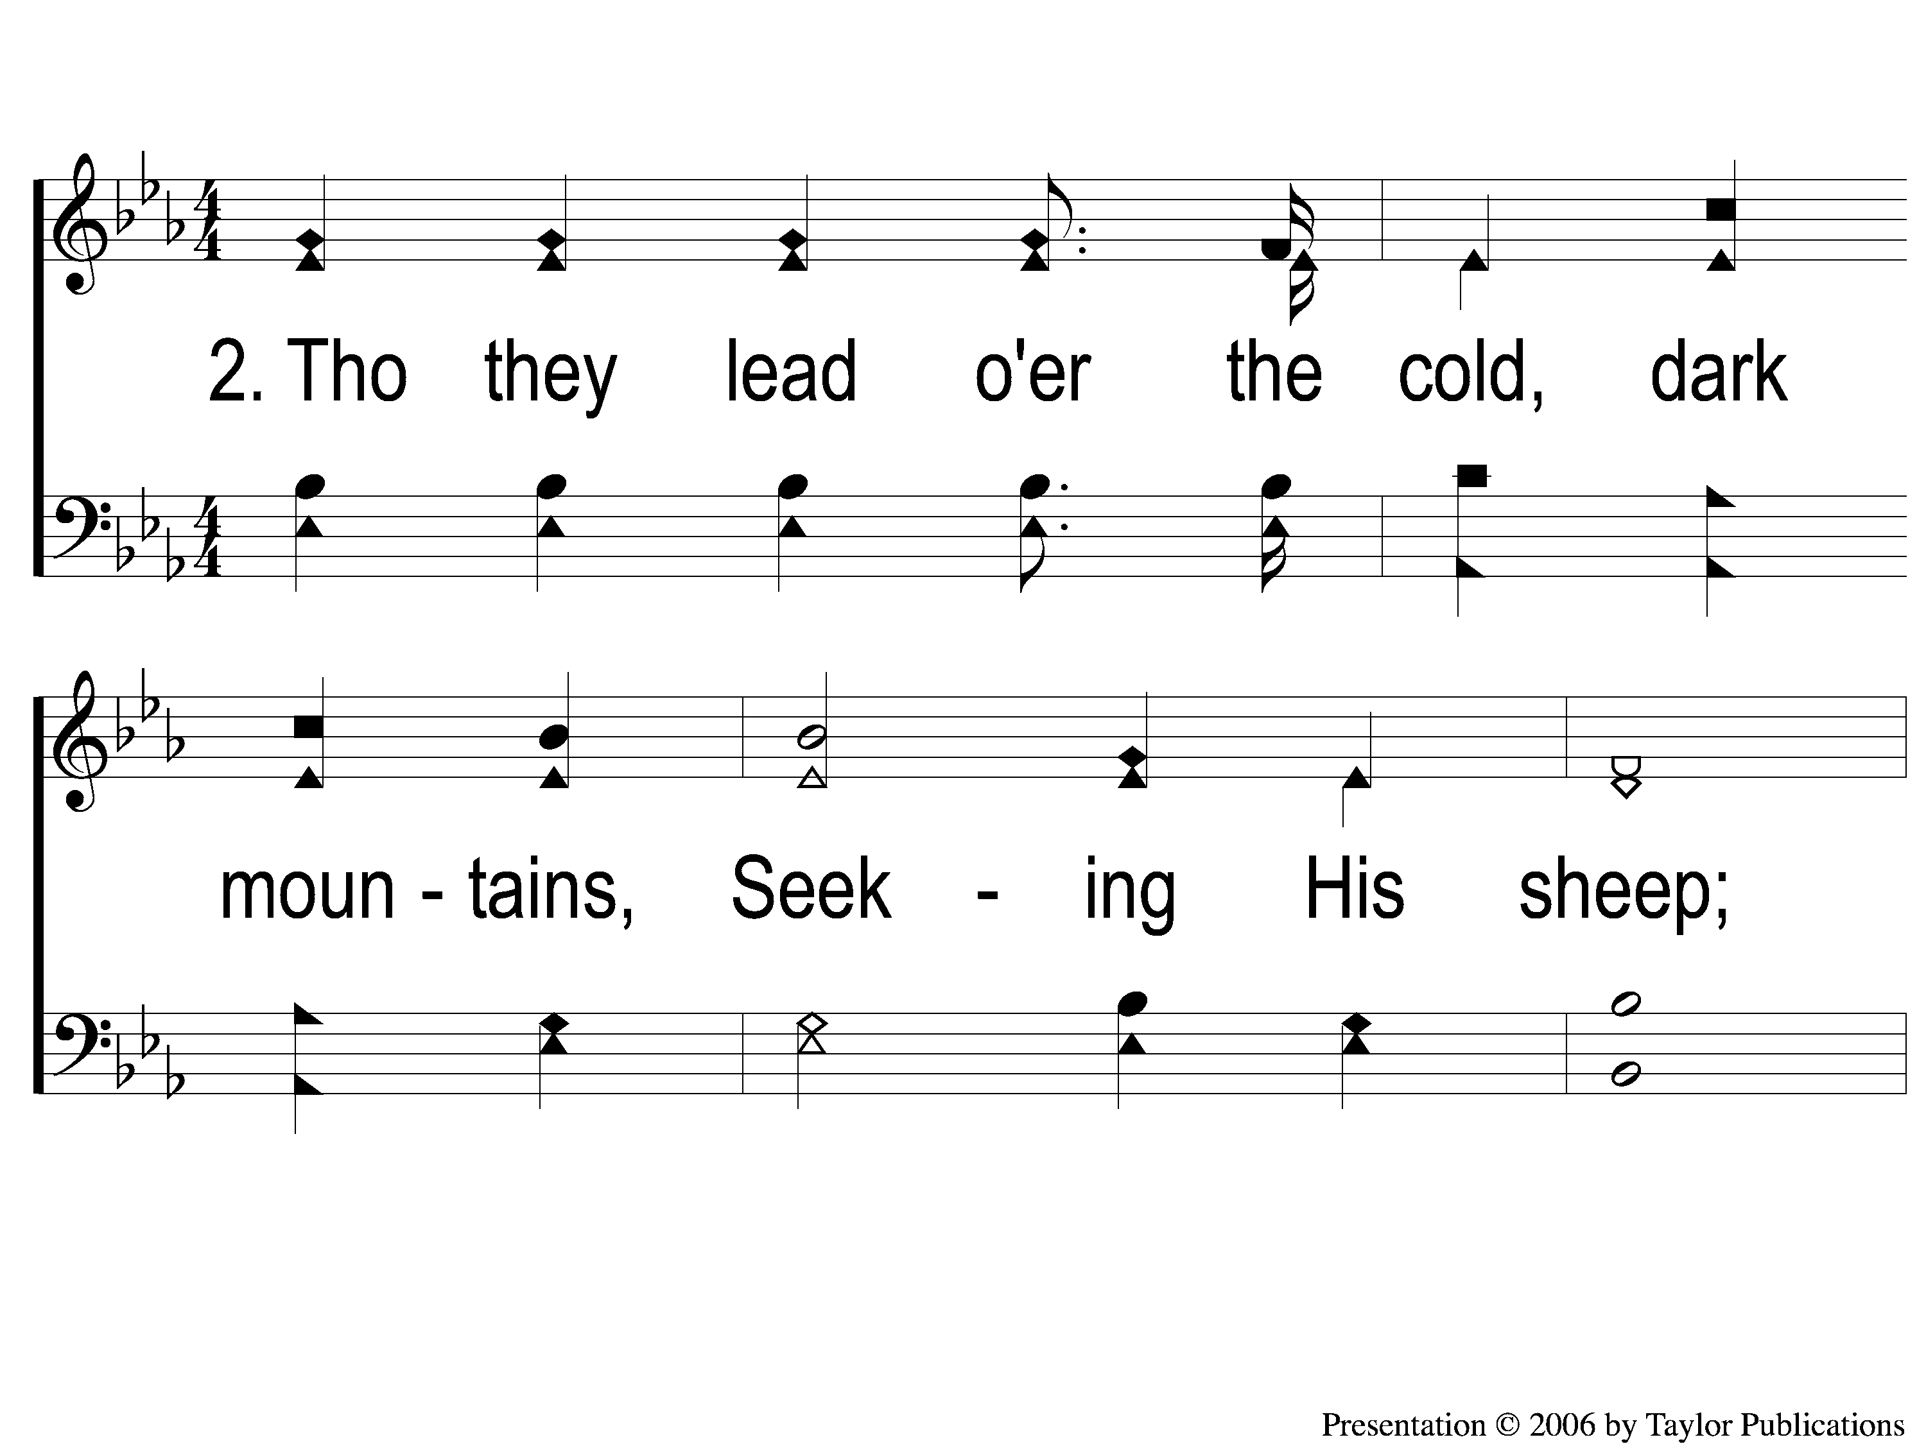
2-1 Footprints of Jesus
Footprints Of Jesus
113

Slide 6
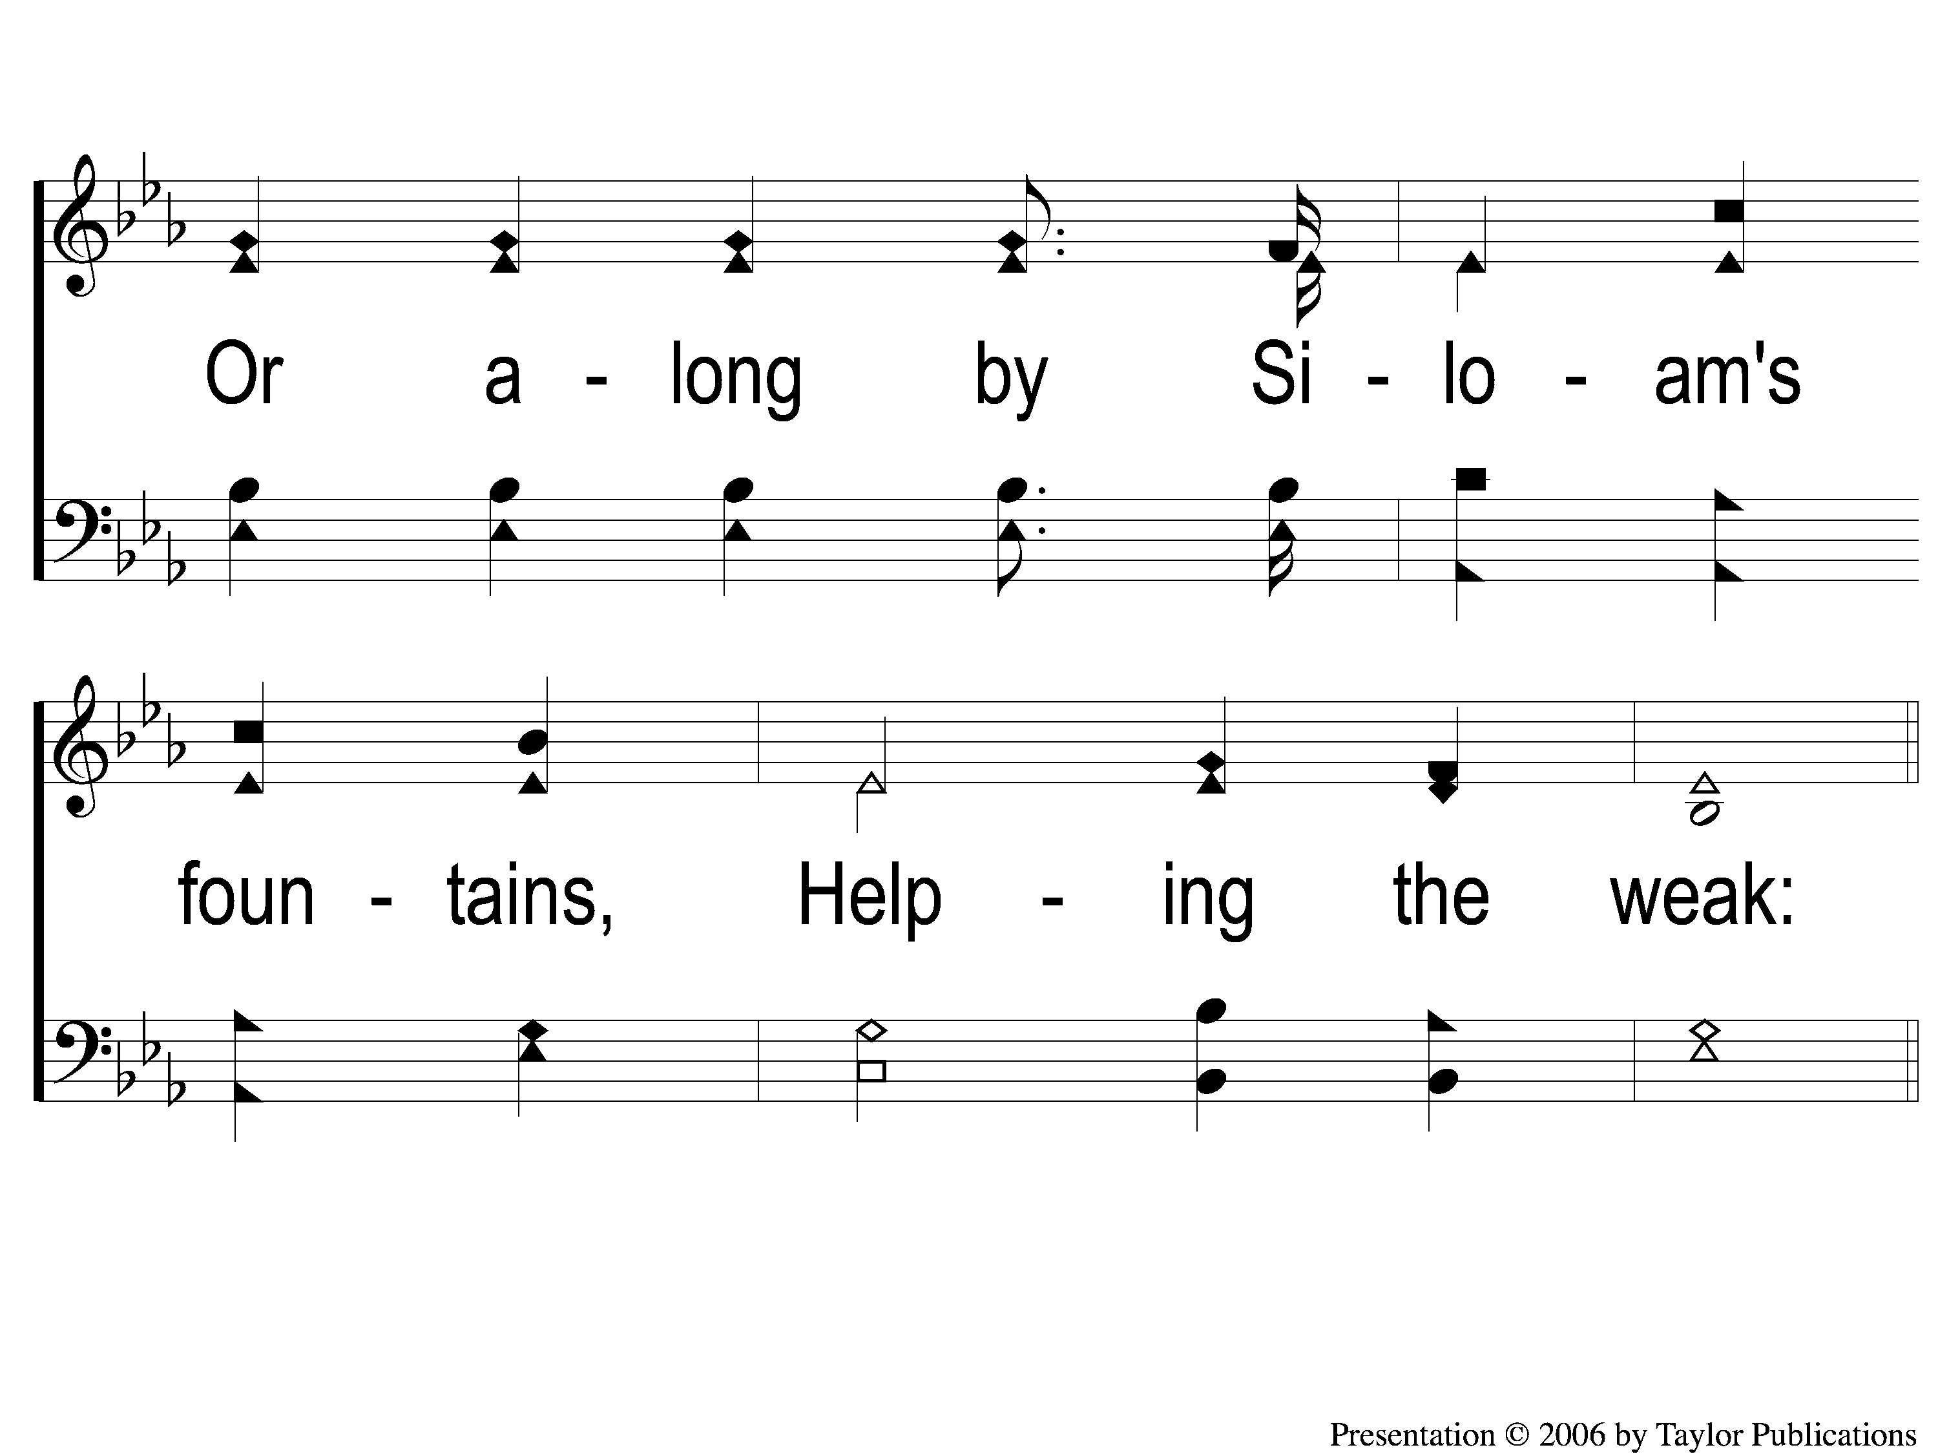
2-2 Footprints of Jesus
Footprints Of Jesus
113

Slide 7
C-1 Footprints of Jesus
Footprints Of Jesus
113

Slide 8
C-2 Footprints of Jesus
Footprints Of Jesus
113

Slide 9
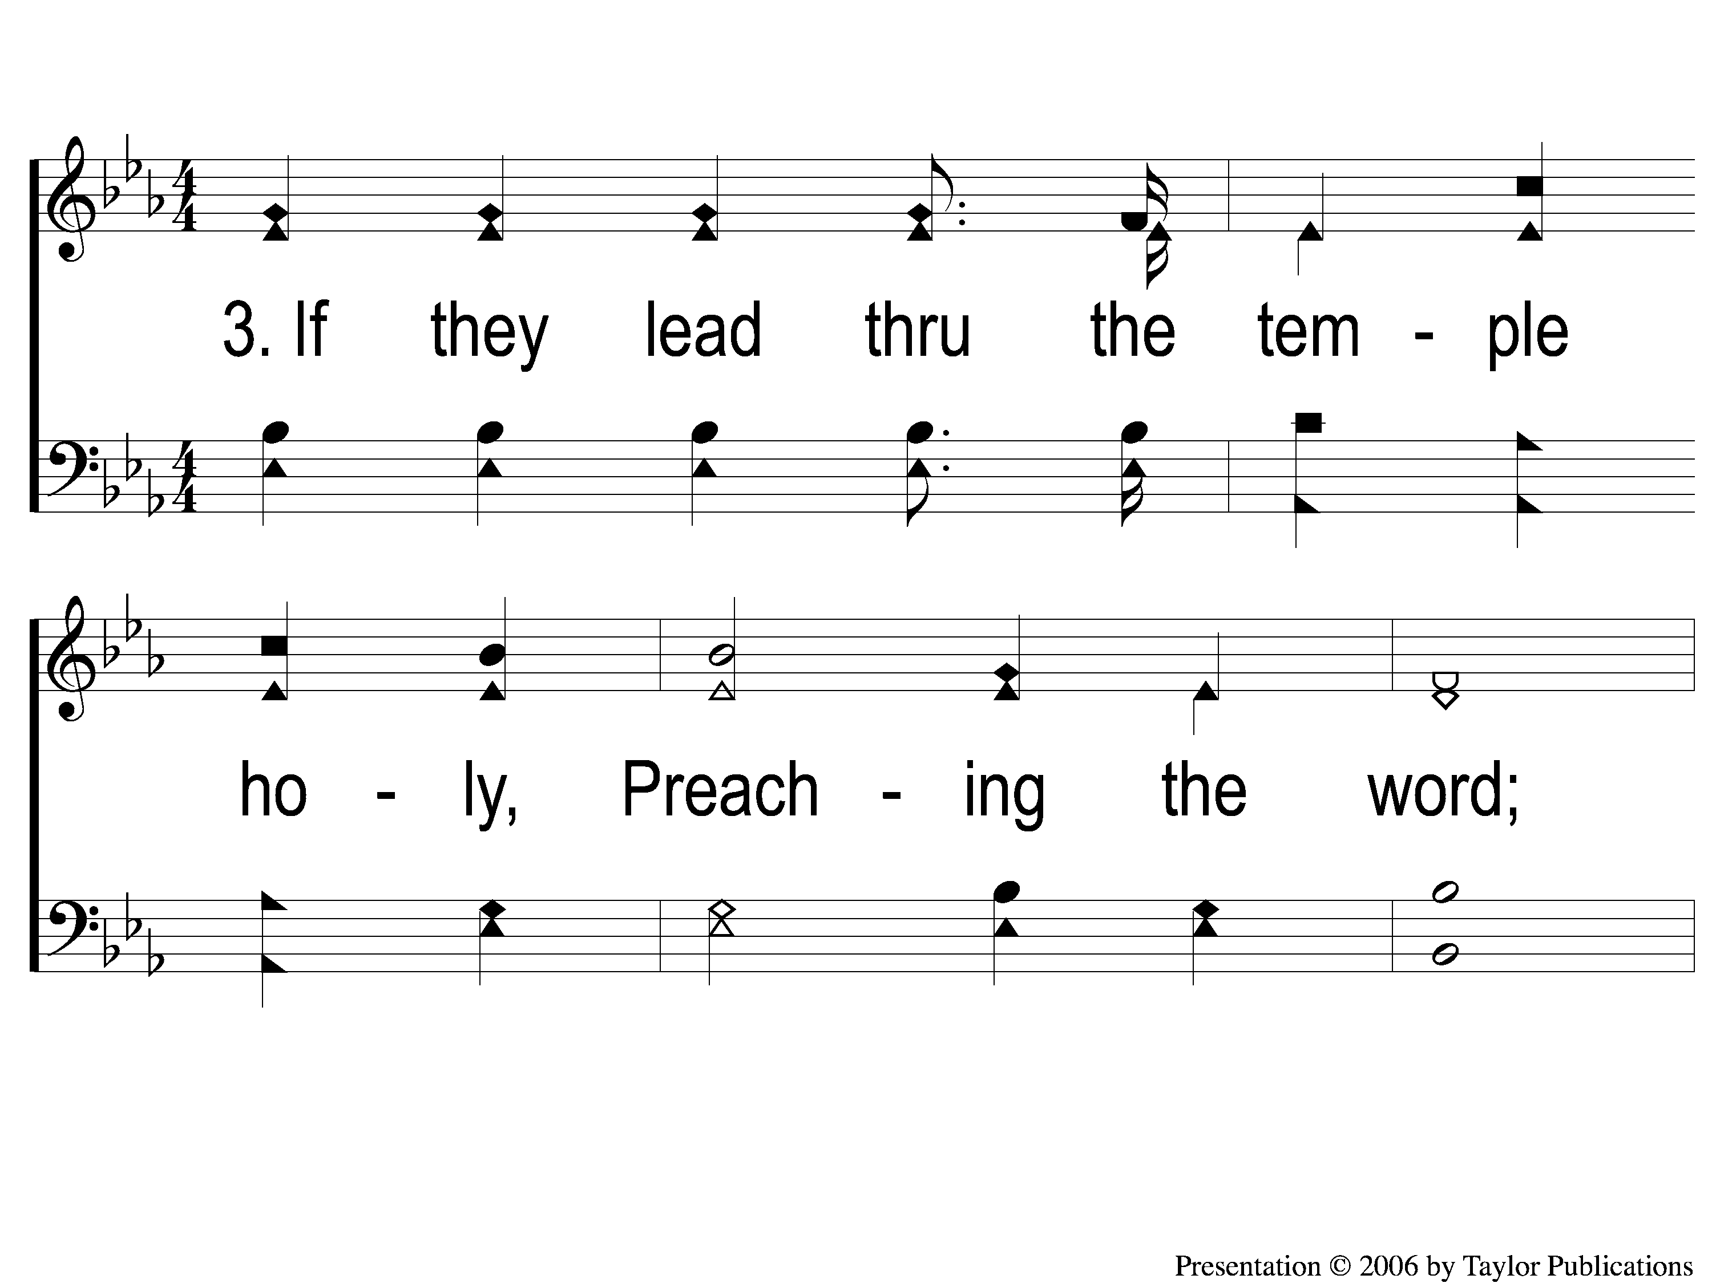
3-1 Footprints of Jesus
Footprints Of Jesus
113

Slide 10
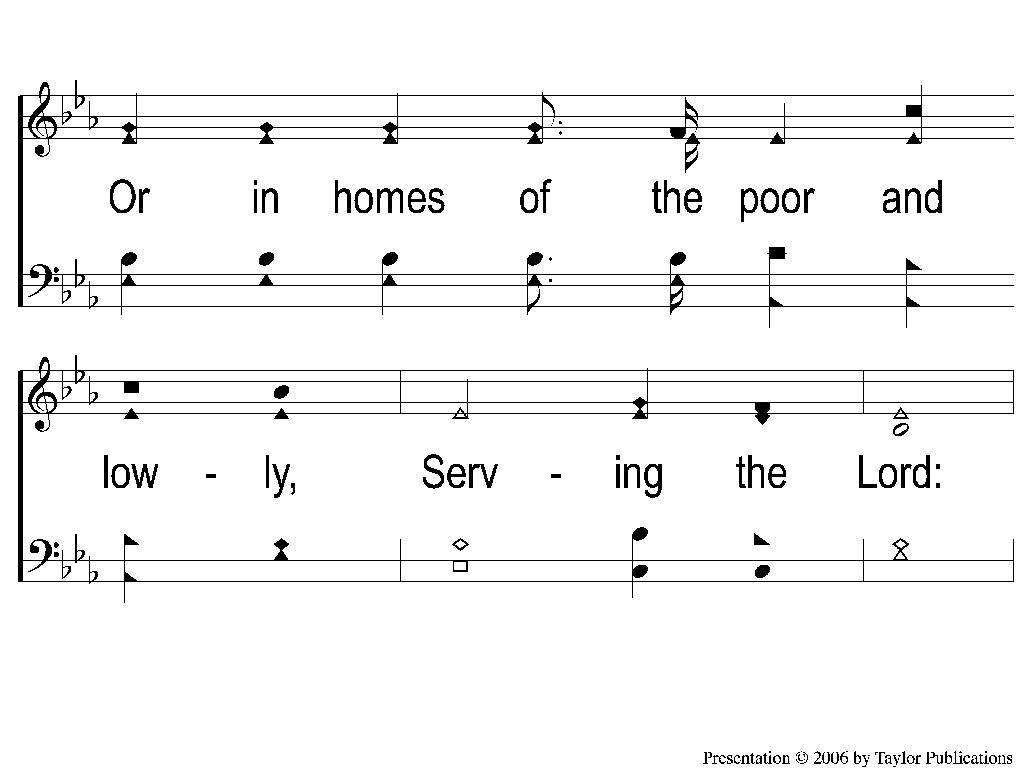
3-2 Footprints of Jesus
Footprints Of Jesus
113

Slide 11
C-1 Footprints of Jesus
Footprints Of Jesus
113

Slide 12
C-2 Footprints of Jesus
Footprints Of Jesus
113

Slide 13
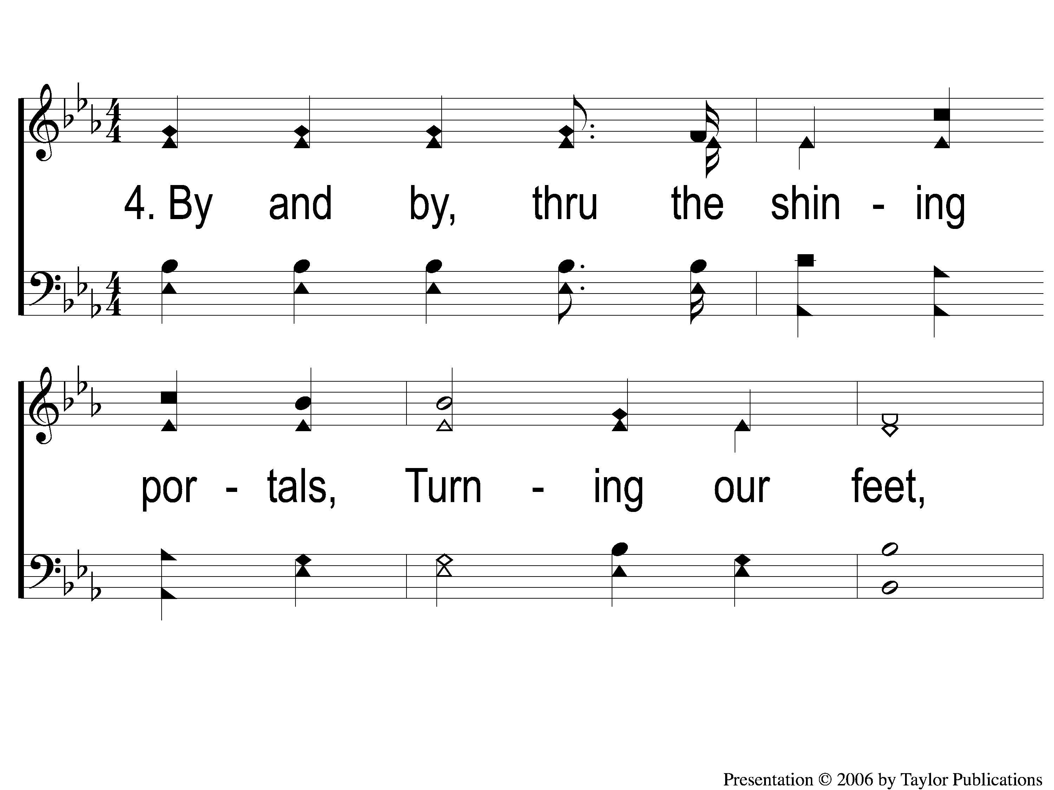
4-1 Footprints of Jesus
Footprints Of Jesus
113

Slide 14
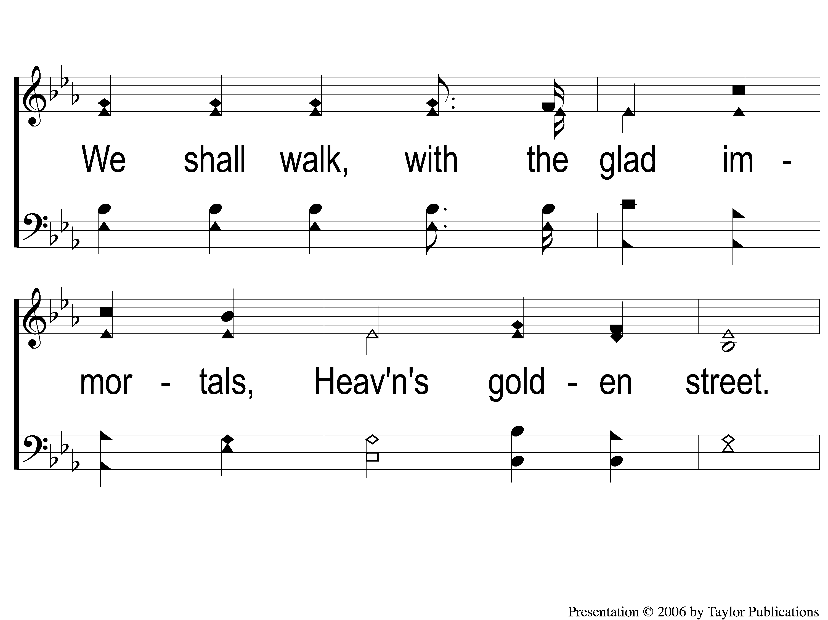
4-2 Footprints of Jesus
Footprints Of Jesus
113

Slide 15
C-1 Footprints of Jesus
Footprints Of Jesus
113

Slide 16
C-2 Footprints of Jesus
Footprints Of Jesus
113

